Slide 1


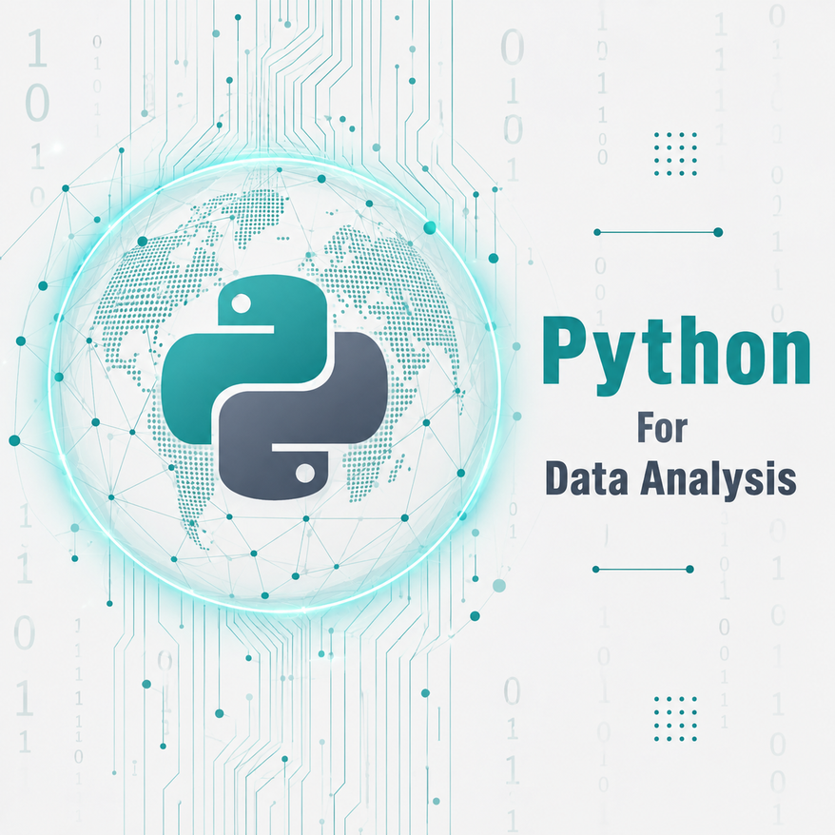




DATA ANALYSIS
Module 5: Python For Data Analysis
Python Fundamentals, Consolidated
Topic 1 of 4

Slide 2




MODULE 5 OBJECTIVES
Use core Python building blocks — variables, data types, operators, and control flow (if/elif/else, loops).
Work with Python's data structures, strings, lists, tuples, sets, and
dictionaries.
Write and call functions, using return, default arguments, and scope correctly.
Recognize common beginner mistakes before moving on to import and external libraries
Notes:
1.7.2013
‹#›

Slide 3


Learning outcome
By the end of this topic, the trainee can…
1- Write and run Python code using variables, data types, operators, and control flow to apply rules to data.
2- Create, access, and modify strings, lists, tuples, sets, and dictionaries to organize information.
3- Define and call functions with return values and default arguments to make code reusable.
Notes:
1.7.2013
‹#›

Slide 4
The road you have already travelled
1
Introduction to Python
2
Python Syntax & Basics
3
Variables & Data Types
4
Operators & Expressions
5
Conditional Statements
6
Loops
7
Strings
8
Lists & Tuples
9
Sets & Dictionaries
10
Functions

Slide 5
Getting started & the rules of the language
› Programming is precise, step-by-step instructions, logic, not maths genius.
› Indentation — 4 spaces defines a block, in place of { }.
› Comments start with # — explain the WHY, not the what.
› print() displays output; sep and end control the formatting.
python
# Indentation defines the block
if name:
print("Welcome aboard!")

Slide 6
Variables & Data Types
› Variables are named containers. = assigns, == compares.
› snake_case — descriptive, no spaces, no leading digits, no keywords.
› int whole numbers · float decimals · str text · bool True/False.
› type() tells you what a value actually is.
python
# The single most useful pattern so far
age = 50
price = 19.99 # float
active = True # bool
print(type(age)) # <class 'int'>

Slide 7
Operators & Expressions
› Arithmetic + - * / // % **
› / always returns a float — 10 / 2 gives 5.0, not 5.
› // floors and % gives the remainder (the even/odd test).
› Assignment += -= *= /= updates a variable in place.
› Comparison == != < > <= >= always return True or False.
› Logical and (both) · or (at least one) · not (flip).
› Precedence () > ** > * / // % > + - > comparisons > and / or
python
17 / 5 # 3.4 true division
17 // 5 # 3 floor division
17 % 5 # 2 remainder
2 ** 3 # 8 power
# Write a full comparison on each side
if age > 6 and age < 60:
print("Eligible")

Slide 8
Control Flow: Conditional Statements
› if condition: runs the block only when True. The colon is required.
› if / else gives exactly two paths — one always runs.
› if / elif / else — the first matching condition wins.
› Use elif rather than stacked ifs for exclusive cases.
› Falsy values: 0, "", [], {}, None. Everything else is truthy.
› So if my_list: reads better than if len(my_list) > 0:

Slide 9
Control Flow: Loops
› while condition: repeats while True — use when the count is unknown.
› You must update the loop variable, or you create an infinite loop.
› for item in sequence: runs once per item — cleaner for known sequences.
› range(stop) , range(start, stop), range(start, stop, step).
› stop is EXCLUSIVE — range(10) gives 0–9, not 0–10.
› break exits the loop · continue skips to the next iteration.
› enumerate() gives you the index and the value together.
python
for i in range(1, 6):
print(i) # 1 2 3 4 5
count = 1
while count <= 5:
print(count)
count += 1 # critical!

Slide 10
Strings in Python
› Indexing s[0] is first, s[-1] is last — zero-based.
› Slicing s[start:stop:step] — stop excluded; s[::-1] reverses.
› Strings are immutable — you cannot change one in place.
› So always reassign — text = text.strip(), never text.strip() alone.
› Key methods .lower() .upper() .strip() .replace() .split() .join() .find() .count()
› f-strings f"{name} scored {score:.2f}" — the modern way to format.
python
text = " Data Science "
clean = text.strip().lower()
words = "a b c".split() # ['a','b','c']
"-".join(words) # 'a-b-c'
print(f"{clean} has {len(clean)} chars")

Slide 11
Data Structures: Lists & Tuples
› List [a, b, c] — mutable, ordered, zero-indexed.
› Add .append(v) at the end · .insert(i, v) at a position.
› Remove .pop(i) takes an INDEX · .remove(v) takes a VALUE.
› Also .sort(), len(), sum(), max(), min(), and in
› Tuple (a, b, c) — immutable and ordered; for fixed data.
› A one-item tuple needs the comma: (x,)
› Unpacking name, age, course = record
python
scores = [82, 91, 74]
scores.append(88)
scores.sort()
print(max(scores), sum(scores))
# Tuples cannot be changed
point = (10, 20)
x, y = point # unpacking

Slide 12
Data Structures: Sets & Dictionaries
› Set {a, b, c} — unique and unordered; duplicates disappear.
› set() creates an empty set — {} creates a dictionary!
› Set operations | union · & intersection · - difference · ^ symmetric
› Dictionary {"key": value} — labelled records, accessed by key.
python
# Sets remove duplicates instantly
unique = set([1, 2, 2, 3]) # {1, 2, 3}
student = {"name": "Ada", "age": 22}
student["city"] = "Abuja"
for key, value in student.items():
print(key, ":", value)

Slide 13
Functions
› def name(): defines it — nothing runs until you call it.
› name() calls it. Without the (), you only print the function object.
› Parameters live in the definition; arguments are the values you pass.
› return sends a value back so it can be used or stored.
› No return means the function gives back None.
› Default arguments def f(x, y=10): — defaults must come last.
› Scope — locals live only inside; prefer parameters over global.
python
def average(numbers):
return sum(numbers) / len(numbers)
print(average([82, 91, 74])) # 82.33
def greet(name, greeting="Hello"):
return f"{greeting}, {name}!"
greet("Ada") # uses default

Slide 14
The seven mistakes that cost the most marks
Missing colon or wrong indent
IndentationError / SyntaxError — four spaces, always.
Using = instead of ==
= assigns a value, == compares two values.
Assuming range(10) is 1–10
It is 0–9. The stop value is always excluded.
Swapping .pop() and .remove()
.pop() takes an index, .remove() takes a value.
Calling a function without ()
average shows the object; average(x) runs it.
Not reassigning a string method
text.strip() is lost unless you capture it.

Slide 15
From fundamentals to data analysis
list
→
a column of values — a pandas Series
dictionary
→
one record — a single row of a table
list of dictionaries
→
a whole table — a DataFrame
for loop + if
→
filtering rows by a condition
function
→
a reusable transformation over a dataset
f-string
→
formatted, readable reporting of results

Slide 16
Python Analyst Readiness Check
Answer from memory before opening your notebook.
1
Which data type would you use to store one full transaction record with named fields?
2
What is the practical difference between a list and a dictionary?
3
Why would an analyst write a function instead of repeating the same code for every branch?

Slide 17

Key Takeaways
Use Python data structures to organize data.
Apply control flow and loops to process data.
Up Next: Loading and
Write reusable code with functions and libraries.
Inspecting Data with
Pandas
Notes:
1.7.2013
‹#›

Slide 18


Key Takeaways
Variables name and save your data.
const is the standard choice.
Up Next: Data Types
let is for specific updates.
Never use var.
Notes:
1.7.2013
‹#›

